Slide 1
Mathematical Models in the Sociological Imagination
Nathan Alexander, PhD
Division of Mathematics and Computational Sciences
Morehouse College

Slide 2
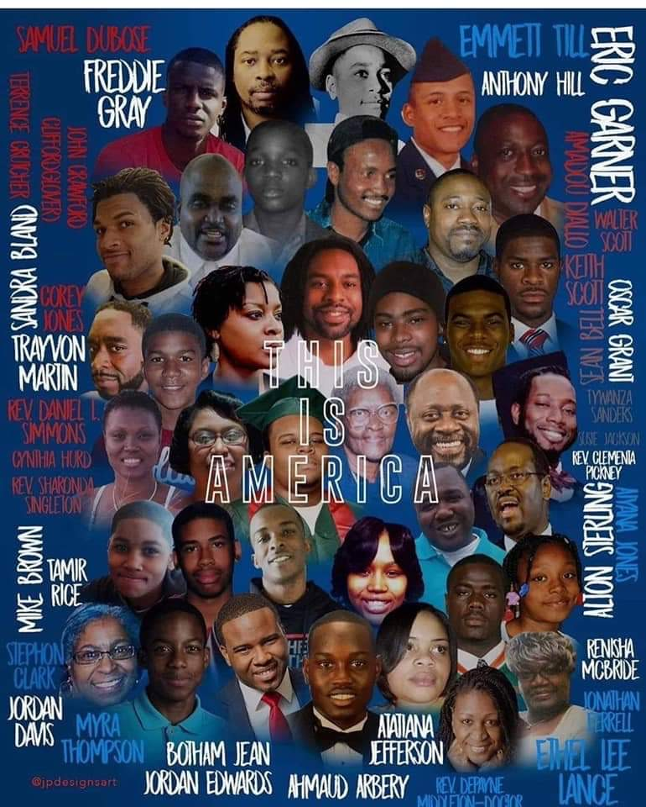

Slide 3
Overview of the Talk
Part 1: History, theory; justice
Part 2: Mathematical models
Part 3: Community work, the youth, futurity
Notes:
In today’s talk, I will briefly overview a project that has been in development and implementation over the last five years, since my arrival in Oakland, California.
I will first discuss the broader motivation behind the project and the focus of this talk.
I will move on to talk about two of the models that my students and I considered.
I will end by talking about how we have engaged students using some of the work of scholars doing social justice mathematics.

Slide 4
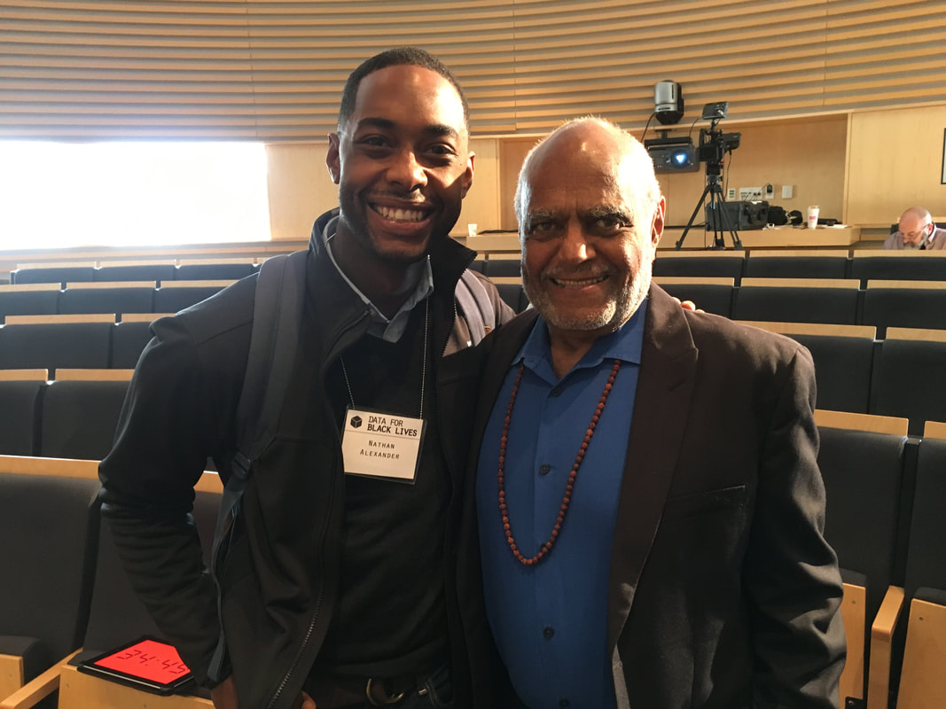
Overview of the Talk
Part 1: History, theory; justice
Part 2: Mathematical models
Part 3: Community work, the youth, futurity
Notes:
In today’s talk, I will briefly overview a project that has been in development and implementation over the last five years, since my arrival in Oakland, California.
I will first discuss the broader motivation behind the project and the focus of this talk.
I will move on to talk about two of the models that my students and I considered.
I will end by talking about how we have engaged students using some of the work of scholars doing social justice mathematics.

Slide 5
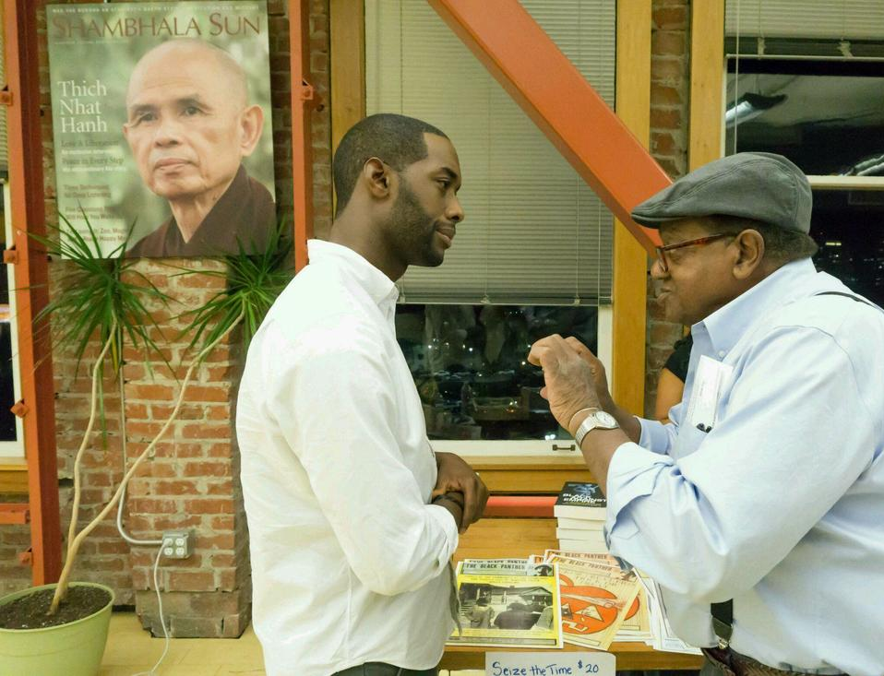
Overview of the Talk
Part 1: History, theory; justice
Part 2: Mathematical models
Part 3: Community work, the youth, futurity
Notes:
In today’s talk, I will briefly overview a project that has been in development and implementation over the last five years, since my arrival in Oakland, California.
I will first discuss the broader motivation behind the project and the focus of this talk.
I will move on to talk about two of the models that my students and I considered.
I will end by talking about how we have engaged students using some of the work of scholars doing social justice mathematics.

Slide 6
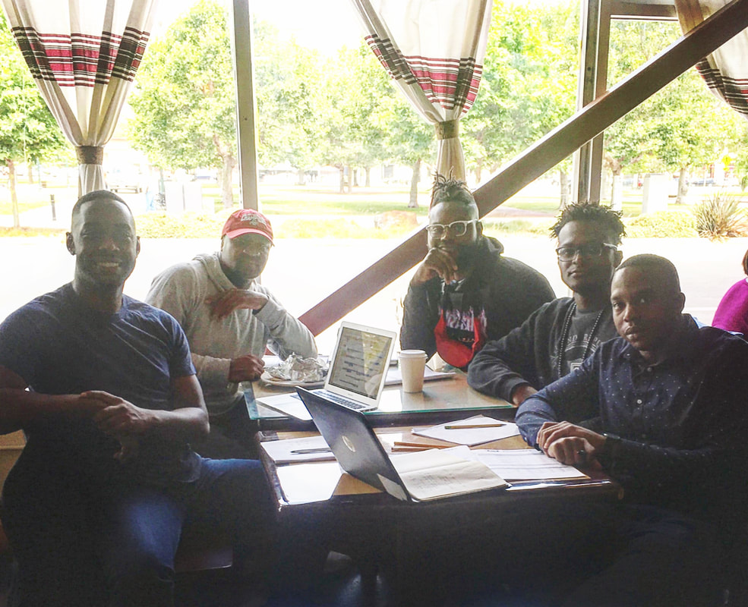
Overview of the Talk
Part 1: History, theory; justice
Part 2: Mathematical models
Part 3: Community work, the youth, futurity
Notes:
In today’s talk, I will briefly overview a project that has been in development and implementation over the last five years, since my arrival in Oakland, California.
I will first discuss the broader motivation behind the project and the focus of this talk.
I will move on to talk about two of the models that my students and I considered.
I will end by talking about how we have engaged students using some of the work of scholars doing social justice mathematics.

Slide 7
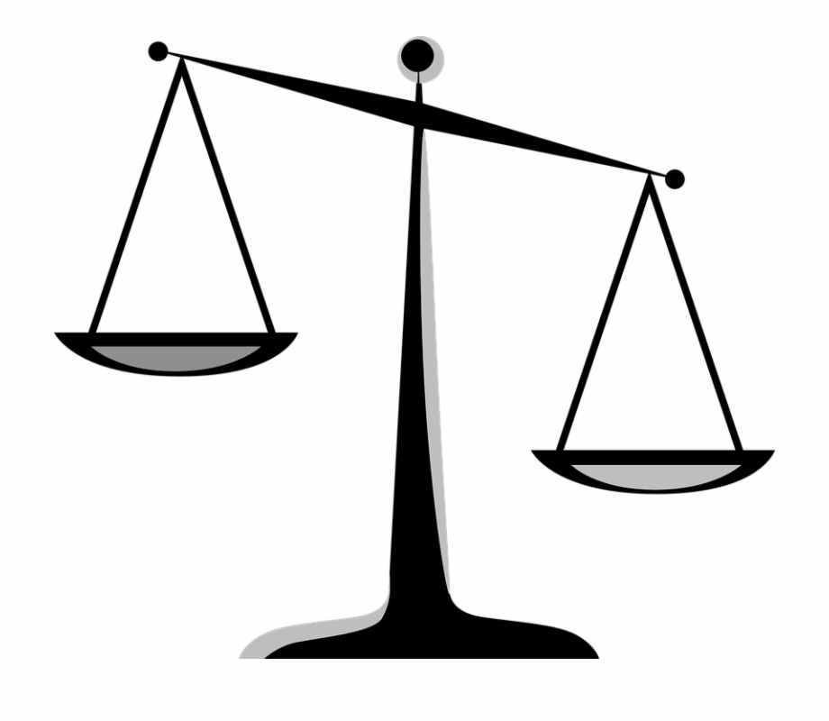
Part 1: History, theory; justice

Slide 8
Hank Willis Thomas, “Rise Up”

Slide 9
Hank Willis Thomas, “Rise Up”

Slide 10
Mathematics, language, and abstraction
The world is understood through symbolic meanings
“Everything we are studying is an abstract object…” (Noam Chomsky)
Idealization is the process to reality
We idealize... to abstract things... to make sense of reality
Ideal and non-ideal societies (Charles Wade Mills)
Oppressive vs. non-oppressive; radical liberalism

Slide 11
“The symbol is not the thing symbolized; the word is not the thing; the map is not the territory it stands for .”
—S. I. Hayakawa, Language in Thought and Action

Slide 12
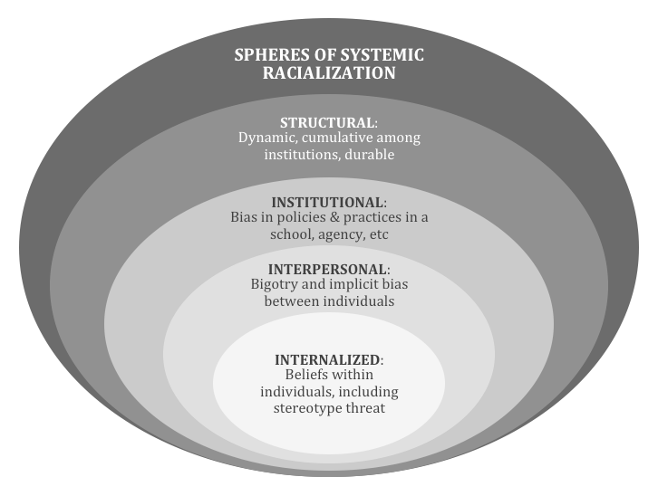
Systems thinking and racial realities
Systems Thinking and Race Workshop
john a. powell, Director
Haas Institute for a Fair and Inclusive Society

Slide 13
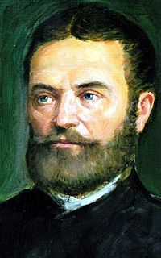
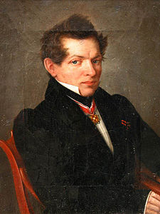
Euclid’s Elements & Geometry
Mathematics, religion, and the utilitarian methods
Bolyai, Lobachevsky, and the abstract maths
“I created a new, different world out of nothing…”
Euclidean (parabolic) vs. non-Euclidean (hyperbolic)
Euclidean geometry centers individuals in the broader
mathematical universe (e.g., up/down, left/right)
Euclid’s fifth postulate and parallelism
Non-Euclidean, hyperbolic, geometry, “freed” mathematicians to study abstract concepts beyond the physical plain via critiques of the established “laws of (plane) geometry”
The culture of contemporary mathematics and the lived reality
Notes:
Around 300 BC, Euclid wrote The Elements, probably the most important math book ever written. He formalized geometry into a series of axioms, rules of inference, and theorems that could be derived from the previous two tools. All of his work stems the five postulates he used to define the structure and language of geometry. They are as follows:
A straight line segment can be drawn joining any two points.
Any straight line segment can be extended indefinitely in a straight line.
Given any straight line segment, a circle can be drawn having the segment as radius and one endpoint as center.
All right angles are congruent.
If two lines are drawn which intersect a third in such a way that the sum of the inner angles on one side is less than two right angles, then the two lines inevitably must intersect each other on that side if extended far enough.
Euclidean and non-Euclidean are contradictory and equally correct. Correct definitions depend on what you intend to prove.
Religion and mathematics. (Kvasz). For instance, the discovery of non-Euclidean geometry is closely associated with the philosophy of German romanticism (see Scholz 1982 and Lewis 1977). Just as the romantic philosophers emphasised the role of subject in creating the picture of the world, mathematicians based the possibility of the creation of new non-Euclidean geometry on this creative force. When a subject is not a mere receptor of reality, it is not merely an empty notice board, on which the pictures of reality are pressed but the other way round - it is an active co-creator of these pictures, then it can also create a new geometry. A new, idealistic conception of the subject is thus concealed in the background of the discovery of the new geometry.
Many mathematicians regard Pythagoras as the founder of their science. On the other hand, Pythagoras is also a great figure from the perspective of the development of religion. The character of the Pythagorean School was that of a religious sect with strict moral regulations, believing in reincarnation and dealing with esoteric disciplines. Pythagoreanism has its origin in the Orphic cult, and therefore to understand the Pythagoreans, it is necessary to follow the religious practices of his adherents (see e.g. Cornford 1912, p. 194-214, Russell 1946, pp. 48-56 or Gorman 1979). Pythagoreanism is of course not the only point of contact between mathematics and the sacred. There is another teaching, where we can find relations between mathematics and religion, namely Kabbalah. Kabbalah is a Jewish doctrine seeking the numbers hidden in the sacred Torah trying to uncover the concealed message of the Scripture by various mathematical calculations. Similarly, in some sacred literature of the ancient Indians we can find different kinds of mathematical knowledge. But we do not have to go to the remote Orient. The builders of Gothic cathedrals possessed in all probability an extensive amount of knowledge, some of which had a mathematical nature.
The aim of the paper is to describe some common patterns in the development of religion and of mathematics. We consider religion to be the place, where a culture establishes its contact with the transcendent reality. Nevertheless the objects of mathematics such as numbers or geometrical figures also transcend the physical world. This means that mathematics is also based on transcendence of physical reality. We try to show that this common basis, namely the transcendence of the physical world, gives rise to some common patterns in the development of religion and of mathematics. In our opinion, religion creates the basic means and ways of transcendence, which are used in the whole culture, including mathematics. So the common patterns in the development of religion and mathematics are not accidental. They belong to the very nature of these subjects.
Boyla. He became so obsessed with Euclid's parallel postulate that his father wrote to him: "For God's sake, I beseech you, give it up. Fear it no less than sensual passions because it too may take all your time and deprive you of your health, peace of mind and happiness in life". János, however, persisted in his quest and eventually came to the conclusion that the postulate is independent of the other axioms of geometry and that different consistent geometries can be constructed on its negation.
He wrote to his father: "I created a new, different world out of nothing.”
This language was achieved through critical perspectives on the assumptions and the resulting implied methodologies

Slide 14
Mathematics and Sociology
Project inquiries: What abstractions might inform critical perspectives on social movement models, and what analyses might lead to critical perspectives in the comparison and refining of these models?
James Coleman’s Mathematics of Social Action (1964, 1968)
Seminal work on collective action and social theory
Psychology basis; privileges the individual within institutions
Individuals as “responsive” or “purposive”
Mathematical sociology situates social theories (informal) within mathematical models (formal) to understand the real-world contexts
Critical Theory (Douglas Kellner, 1989, 2003)
Meta-theoretical concept of “critical theory” to signify (1) critical dimensions, (2) theoretical aspirations, and (3) political dynamics that link theory to practice
Teaching Mathematics for Social Justice (Gutstein, 2006, 2007; Kokka, 2019)
Community, critical, and classical mathematics
Mathematics for wellness and healing
Notes:
This research pulls from three main areas that engage….

Slide 15
Black Intellectual Traditions (Marable, 2000)
Descriptive. Presenting the realities of Black life.
Corrective. Challenge mainstream discourses.
Prescriptive. Envisioning practices to empower.

Slide 16
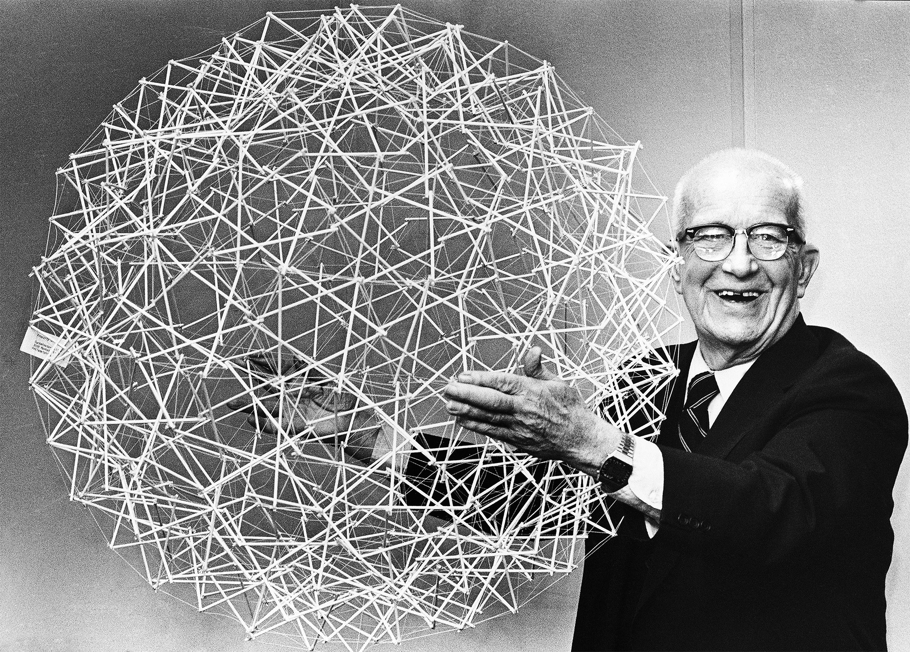

Slide 17
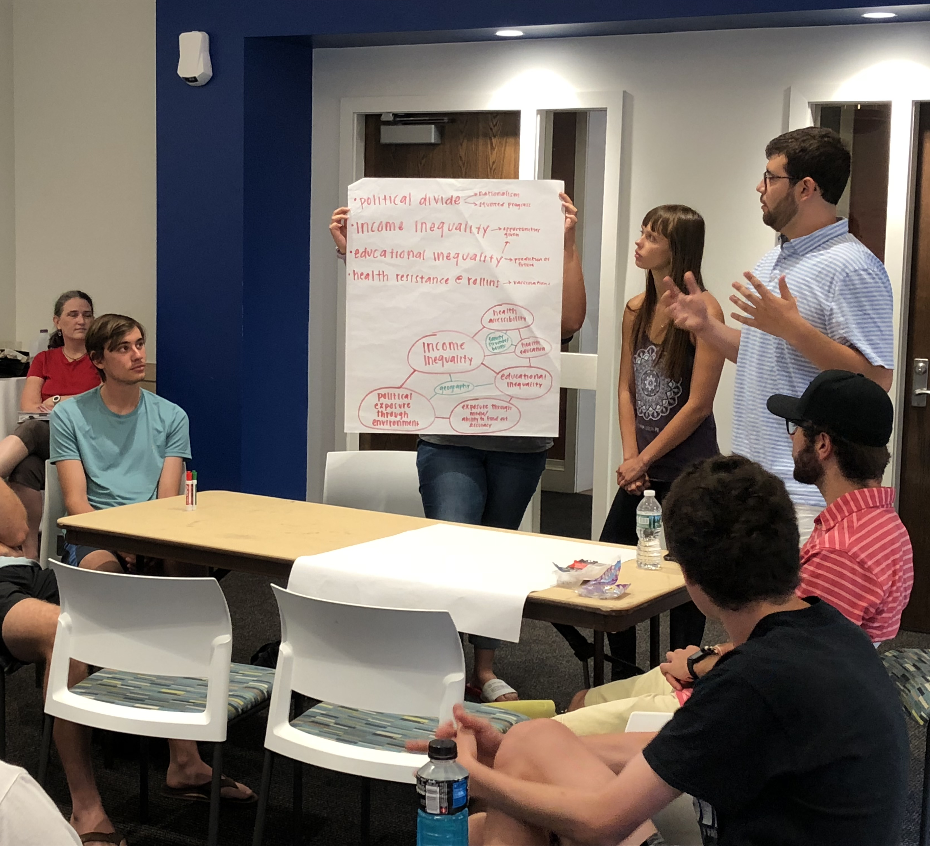
Part 2: Mathematical models

Slide 18
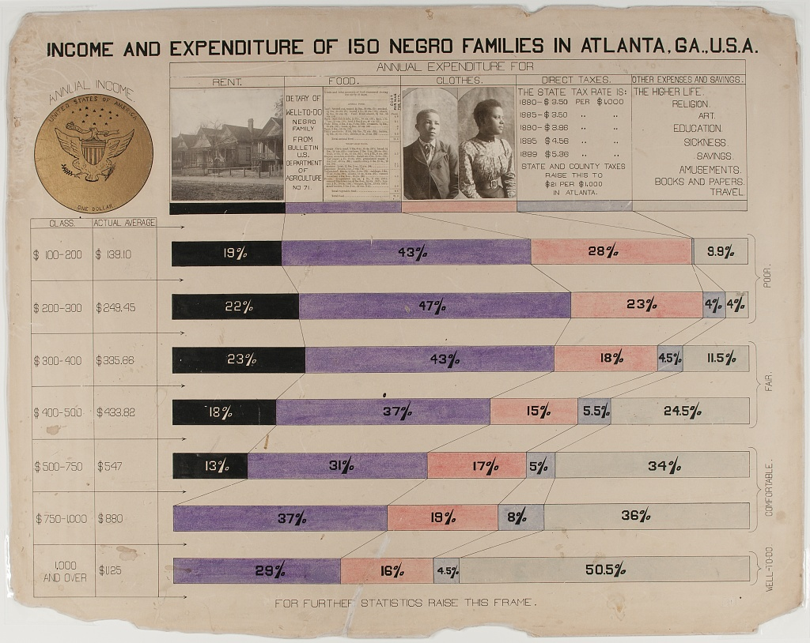
W.E.B. DuBois’ Atlanta Project, 1897-1910

Slide 19
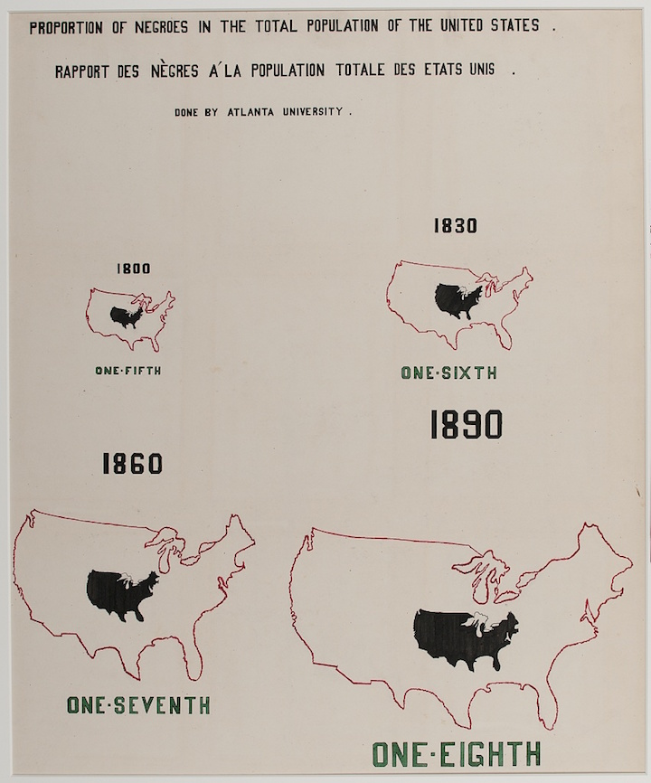
W.E.B. DuBois’ Atlanta Project, 1897-1910

Slide 20
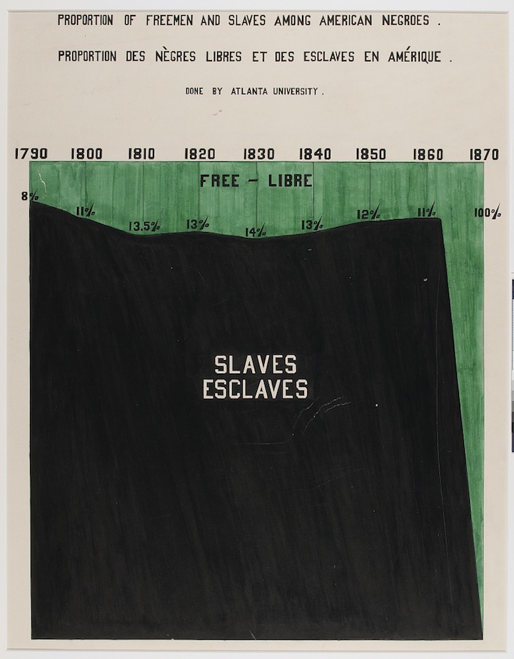
W.E.B. DuBois’ Atlanta Project, 1897-1910

Slide 21
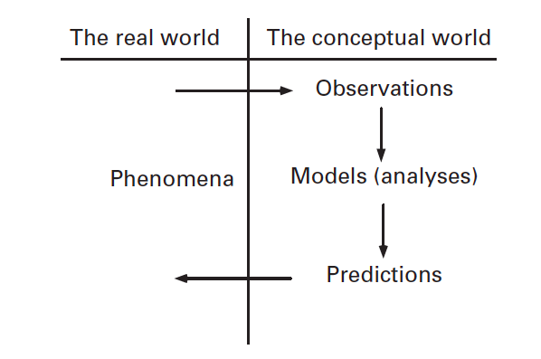
Mathematical modeling

Slide 22
Model 1
The Prisoner’s Dilemma

Slide 23
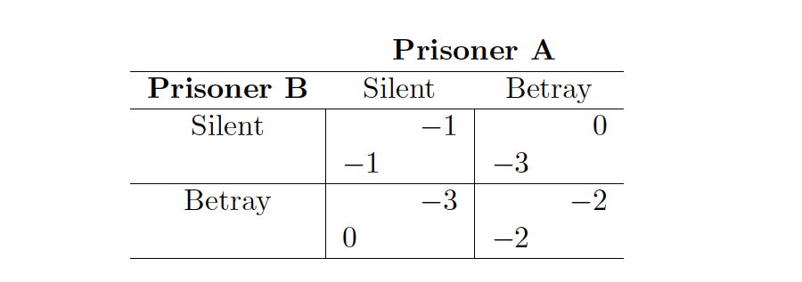
The Prisoner’s Dilemma

Slide 24
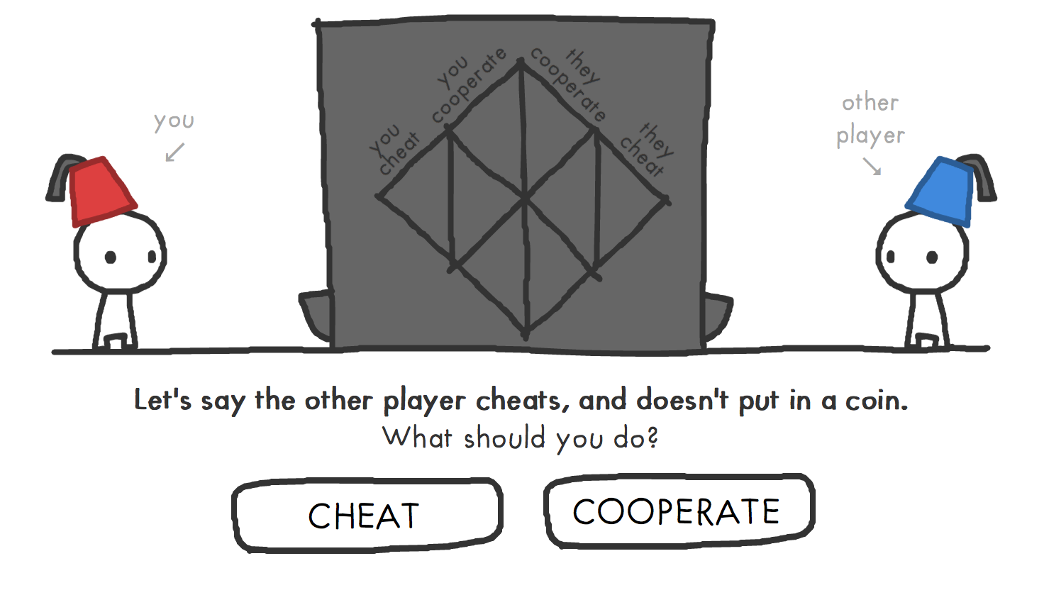
Nicky Case, The Evolution of Trust

Slide 25
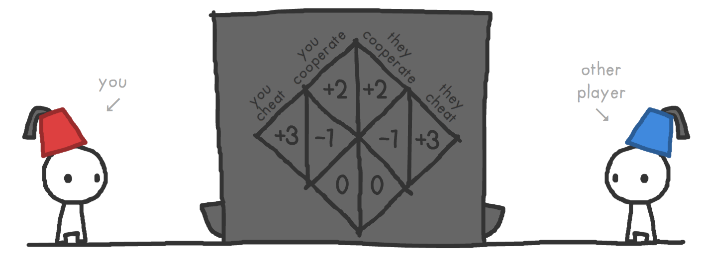
Nicky Case, The Evolution of Trust

Slide 26
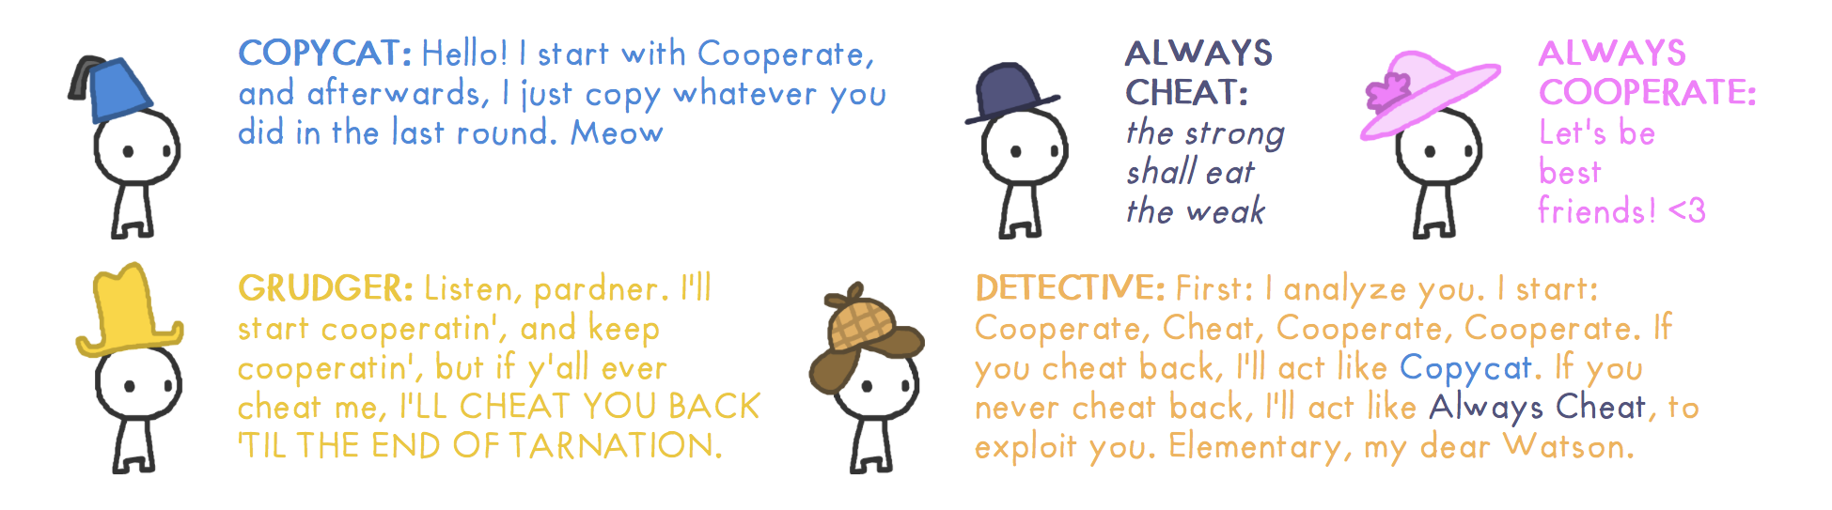
Nicky Case, The Evolution of Trust

Slide 27
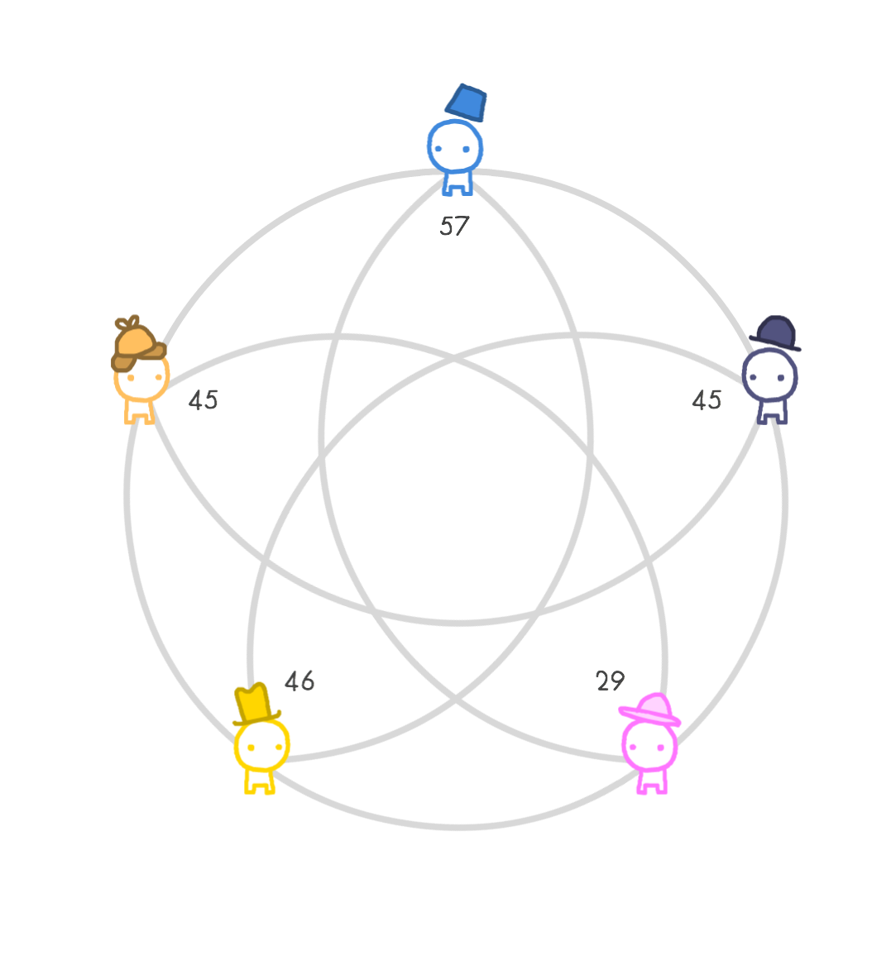
Nicky Case, The Evolution of Trust

Slide 28
Model 2
U.S. Law and Public Policy

Slide 29
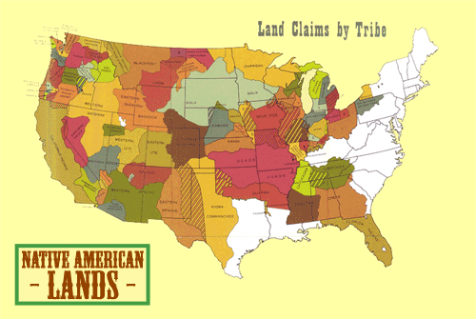

Slide 30
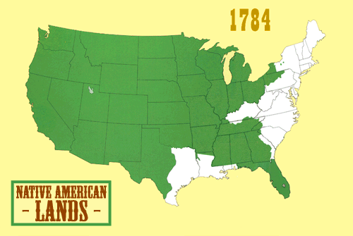

Slide 31
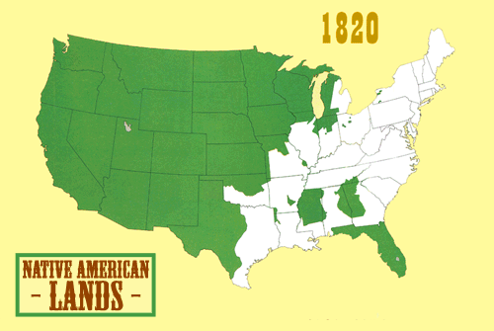

Slide 32
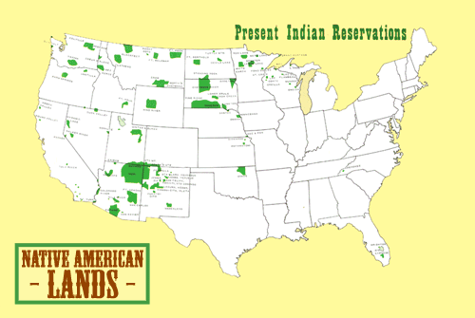

Slide 33
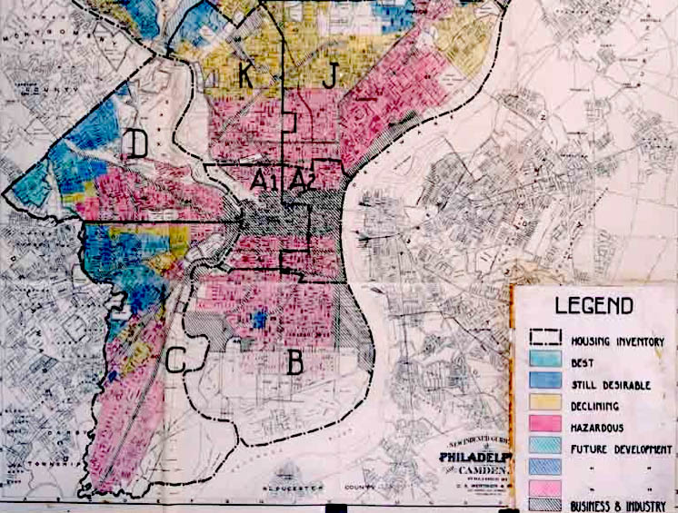
A Brief History of Spatial Analyses
Redlining
Practice of denying services, either directly or through selectively raising prices, to residents of certain geographical areas based on the racial, ethnic, and class makeups of areas.
Spotlights U.S. historical narratives of geography related to colonization (Native Americans), slavery (Blacks), and migration (non-Whites, and White lower classes).
Focuses issues of social justice to geo-spatial contexts
Above. HOLC 1936 security map of Philadelphia, PA showing redlining of lower income neighborhoods.[1] Households and businesses in the red zones could not get mortgages or business loans.
Notes:
While some of the most famous examples of redlining regard denying financial services such as banking or insurance,^{[2]} other services such as health care ^{[3]} or even supermarkets,^{[4]} can be denied to residents (or in the case of businesses like the aforementioned supermarkets, simply moved impractically far away from such residents) to carry out redlining.^{[5]} The term "redlining" was coined in the late 1960s by John McKnight, a sociologist and community activist.^{[6]} It refers to the practice of marking a red line on a map to delineate the area where banks would not invest; later the term was applied to discrimination against a particular group of people (usually by race or sex) irrespective of geography.

Slide 34
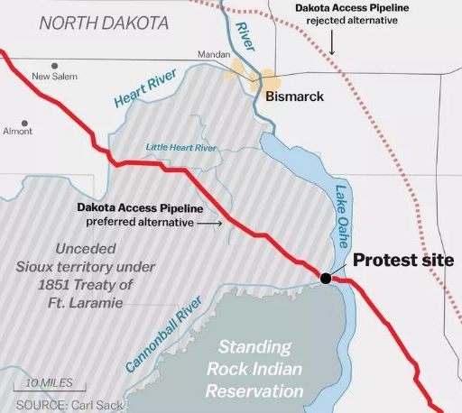
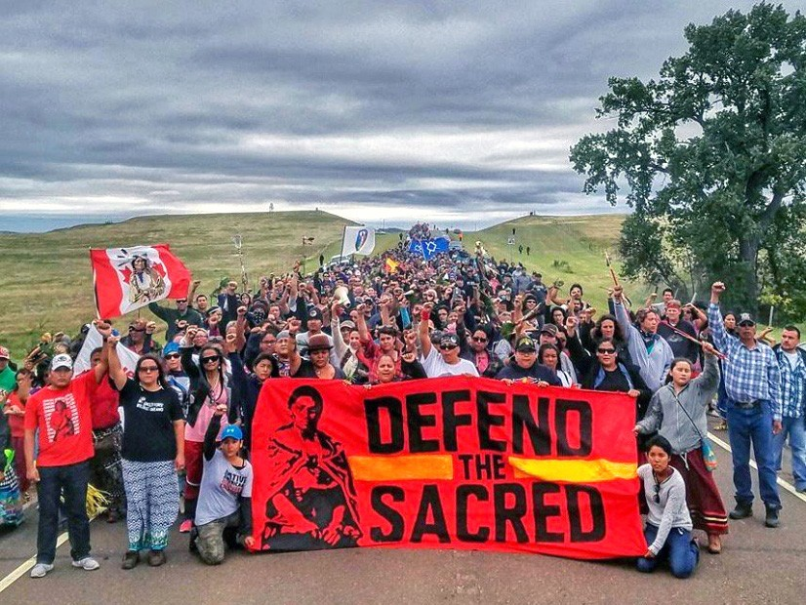

Slide 35
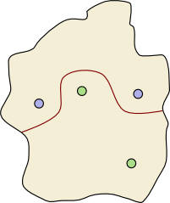
Dividing Walls (Short, 2011)
Topography is a branch of geography concerned with the natural and constructed features on the surface of land, such as mountains, lakes, roads, and buildings.
Topology is a branch of mathematics concerned with the distortion of shapes. Short (2011) explores topological problems using topography.
There is an island containing four towns —
the green tribe live in two of the towns
and the blue tribe in the other two.
The red line represents a dividing wall separating
the blue towns from the green towns.

Slide 36
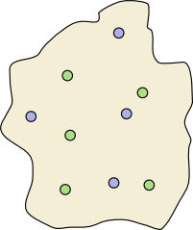
Theorem 1. Given any configuration of blue and green towns, there is a dividing wall that separates blue towns from green towns.
Is there a dividing wall?
What mathematical tools and notes do we need to prove this theorem?

Slide 37
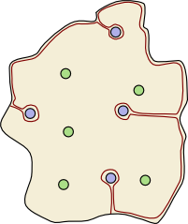
Theorem 1. Given any configuration of blue and green towns, there is a dividing wall that separates blue towns from green towns.
Is there a dividing wall?
What mathematical tools and notes do we need to prove this theorem?

Slide 38
Model 3
Neighborhood Composition

Slide 39
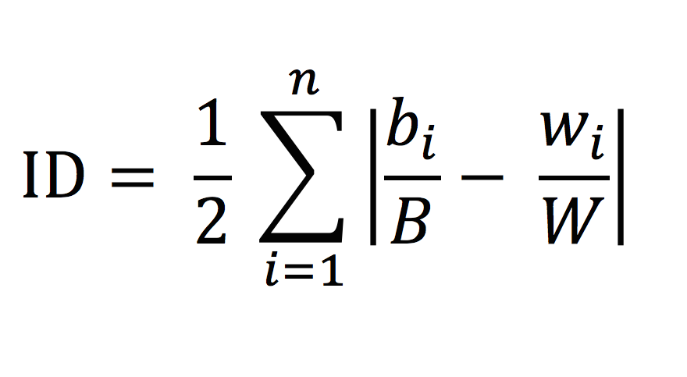
Index of Dissimilarity
𝑏_{i} = the population of group 1th area
𝐵 = the total population for group 1 in the larger geographic area
𝑤_{i} = the population of group 2 in the i^{th} area
𝑊 = the total population for group 2 in the larger geographic area
Notes:
𝑏! = the population of group 1 in the ith area
𝐵 = the total population for group 1 in the larger geographic area
𝑤! = the population of group 2 in the ith area
𝑊 = the total population for group 2 in the larger geographic area

Slide 43
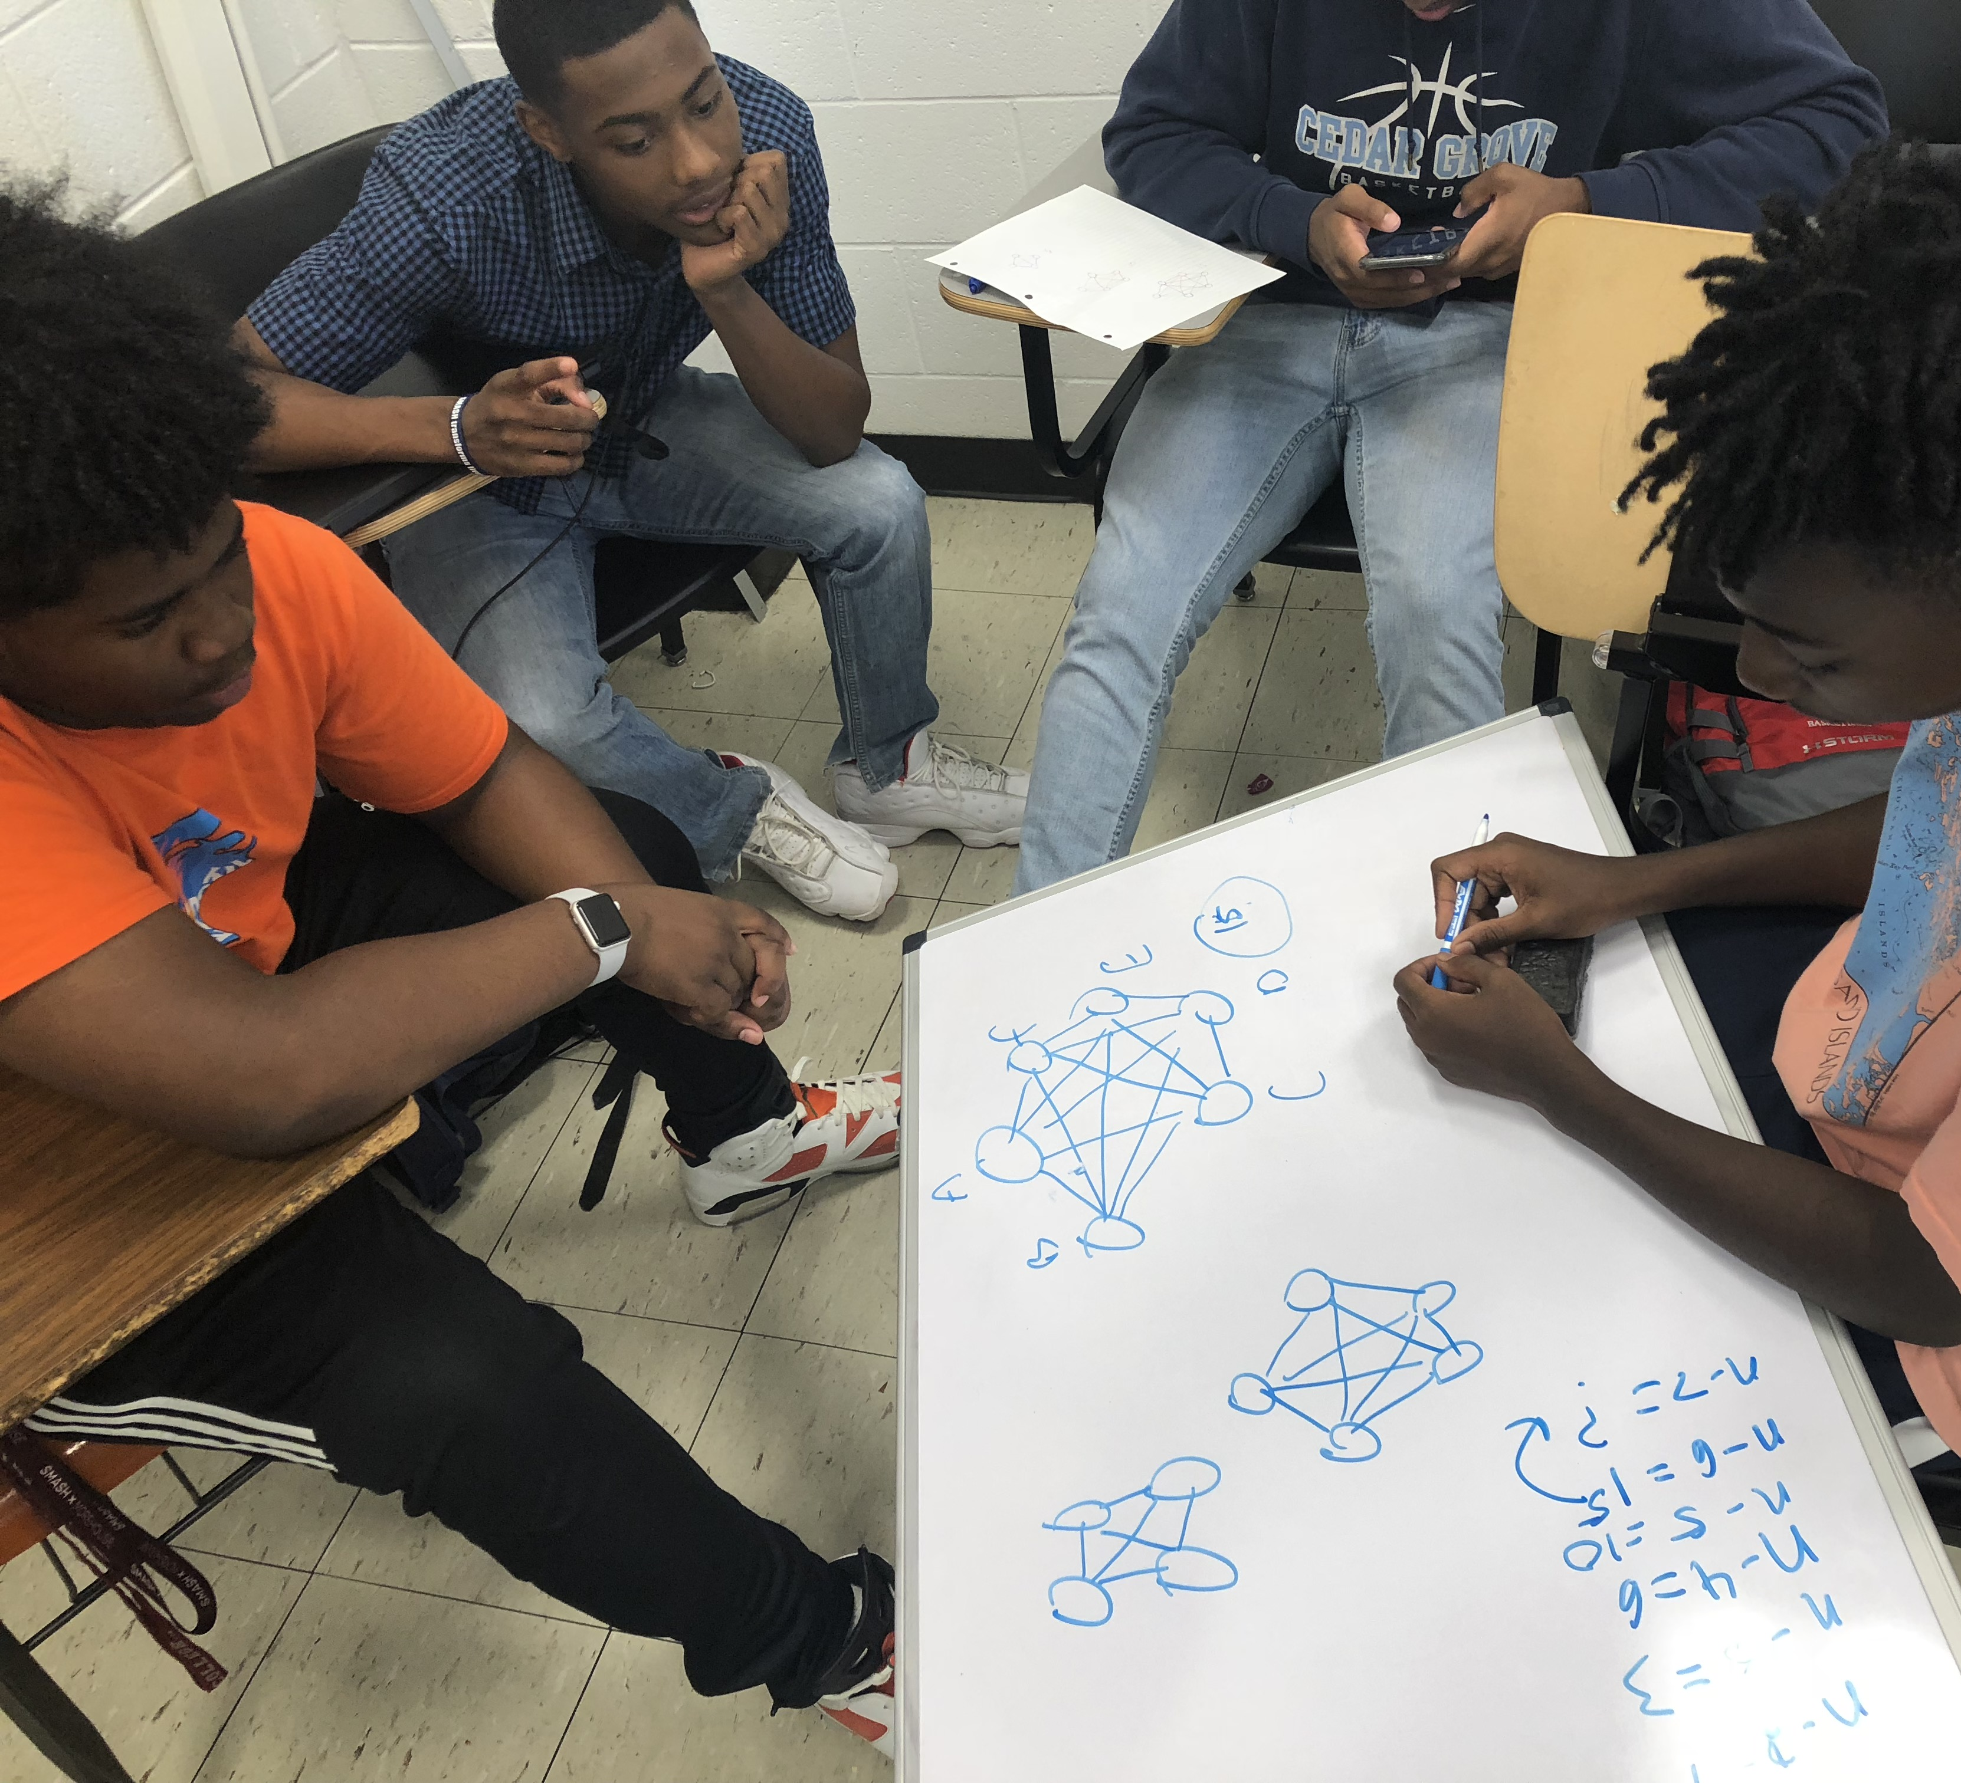
Part 3: Community work, the youth, and futurity

Slide 44
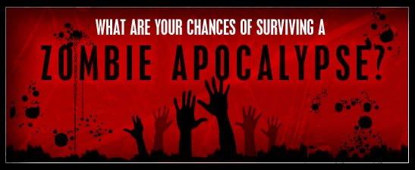
Notes:
Engagement in any classroom is an important component of what I focus on as being “productive”
I begin some of my courses with this activity, to get students to think about their roles and action and contributing to the community.

Slide 45

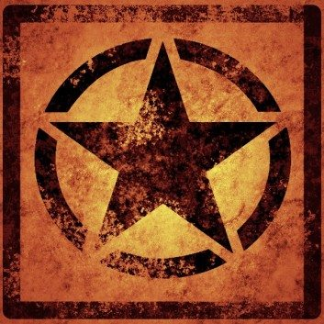


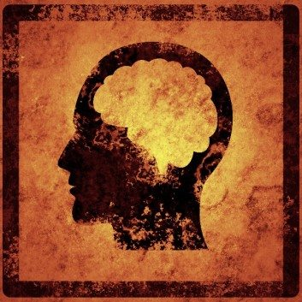
The Apocalypse Has Started – Choose A Main Role Choose a role (based on your strength) for the apocalypse
Communications and Logistics
Help your team generate innovative ideas using effective communication that everyone can understand.
Strategy
Help your team apply knowledge and information already known or provided by previous discussions and notes.
Medical Team
Help your team remedy any problems with mathematical computation and other technical or “triage” issues.
Architect
Think about how others who are not in mathematics might approach explaining your team’s main ideas; maybe visually.
Define your own strength – and tell your team about it.
Notes:
I’d like to engage focus in attendance today, look at these various roles, and talk about where you see yourself, and PUT IT IN THE CHAT FOR OTHERS TO SEE.
You can also write out your role to help to define your own strength.

Slide 46
Organizing for youth worth
You do not need to be a voice for the “voiceless” – pass the mic!
Working in partnership with local communities
Schools, community centers, parents and families
Pooling resources and shifting those resources to your local community
Critical conversations with your colleagues
Paper with Zeynep Teymuroglu and Carl Yerger in PRIMUS
Modeling and problem posing with youth
Forthcoming paper in Journal for Mathematics Education at TC
Sharing with the local communities

Slide 47
Critical Perspectives on Modeling
Acquire knowledge about the process you want to model. It is critical to know about the social processes informing your and others’ models.
Clearly specify the kind of problem you want to solve. Understand the various approaches to modeling, especially when working with social processes.
Understand modeling strategies. Select multiple strategies and explore their assumptions, critique those assumptions, compare and contrast.
Start simply and build carefully within a modeling context. Modeling outside of the specified context may not attend to the complex processes that one is attempting to idealize.
Face the problem of metric. Ask whose perspectives are prioritized and centralized in your model; critique yours to include others’ perspectives.
Identify the scope conditions and assumptions. Ask what are the suppositions taken to be true without proof? How and why do these particular assumptions exist?
Analyze your model, determine its behaviors, conduct experiments. Using community teaching will practices help others to learn and improves practices.
Assess model fit to criterion data. How well does your model fit assumptions?
(Adapted from Oliver & Meyers, 2003)

